Slide 1
ICT for Development
Md. Nuruzzaman, Ph.D.
Director (Training), NAPD

Slide 2
ICT4D
Information and Communication Technologies for Development
Use of Information and Communication Technologies (ICTs) for-
Socioeconomic development
International development
Human rights.
More and better information and communication furthers the development of a society.
(from Wikipedia)

Slide 3
ICT
Computers, Laptops, Tablets, Smartphones
Internet
Email
World Wide Web
FTP, Telnet
IRC
Discussion groups/Forums
Chat & VoIP
Peer-to-Peer (P2P)
Social Media
Mobile - SMS

Slide 4
Mobile phones and SMS
Mass SMS service
Information dissemination
Timely availability of information
Fishing, rural farmers
Matrimonial, horoscope, sales, traffic updates…
Medical & agricultural consultancies

Slide 5
Email
Effective communication
Mailing lists
Topic specific
Associations, NGOs,
Mailmerge (mass mailing)
eNewsletters

Slide 6
World Wide Web
Collection of websites
Also has these
Discussions forums
Social networks
Blogs
Microblog
Chat
Source of information

Slide 7
ICT for Development areas
Livelihood
Education
Health
Weather & Climate
Agriculture
eGovernance

Slide 8
Livelihood
Timely dissemination of vital information
Latest prices, where to send the produce, govt schemes, change in policies, …
Rural & small enterprises
Small farmers
Microfinance
Poverty Reduction through Informal Employment
Rural telecenters, Nemmadi

Slide 9
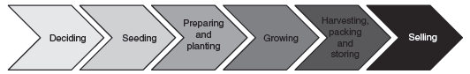
Agriculture
Timely dissemination of vital information
Latest prices, where to send the produce, govt schemes, change in policies, …
Innovations
Ex. -remote starting of water pumps
Expert advice
Crop disease identification & solution
Agricultural value chain
Notes:
The following ICT4D innovation have been found in Taiwan:^{[41]}
A rice germination electronic cooker^{[42]}
A robotic tubing-grafting system for fruit-bearing vegetable seedlings^{[43]}
An air bubble machine and multi-functional, ultrasonic machine for fruit cleaning^{[44]}
India
ASTRA choola
Seeding machine
Remote starting of water pumps
Agricultural value chain
Deciding: At this stage, farmers decide what crop to grow, how much land to allocate for
each crop, and also arrange for financing.
2. Seeding: During this stage, farmers either purchase seeds or prepare their own seeds and
possibly prepare a seed bed.
3. Preparing and planting: During this stage, there is land preparation using labour or
machines and actual planting happens.
4. Growing: At this stage, applying fertilizer, pesticides and water takes place.
5. Harvesting, packing and storing: During this stage, finding labour for harvesting,
finding storage and packing are the main activities.
6. Selling: In the final stage, (some) farmers check prices at the market, find a transportation
method, and transport the packed produce to the market and sell it.
A system of advisory services in India delivered by mobile phones whereby farmers were able to access information related to
crop and nutrient practices to improve their yields. This information, tailored to the needs of 450 farmers in the villages of Sirkali Taluk, Nagapattinam District, India, helped them increase their income by 15 percent

Slide 10
Health
Medical (symptoms, disease & medicine) database
Drug database (effects, side effects, alternates)
Medical & health related apps
Telemedicine
Remote assistance in operations
Medical & health related gadgets

Slide 11
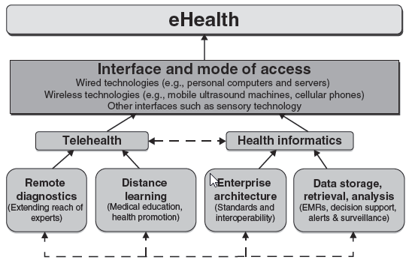
eHealth

Slide 12
Weather & Climate
Weather information & forecast
Helps fishing, farming,..
Weather forecasting, cyclone warning
Disaster management

Slide 13
ICT for Education
Technology for education, technology enabled learning
OLP
Teachers’ training, train the trainer
Online encyclopaedias, learning materials, tutorials, courses
Tablets & content for them
Details of courses, submitting applications online
Online entrance examinations

Slide 14
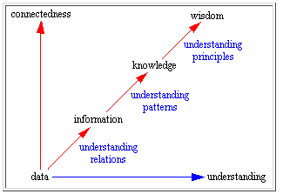
Education

Slide 15
E-Learning
All forms of electronic supported learning and teaching, which are procedural in character and aim to effect the construction of knowledge with reference to individual experience, practice and knowledge of the learner.
Includes Web-based learning, computer-based learning, virtual classrooms and digital collaboration.
Content delivered via the Internet, intranet, satellite TV, CD/DVD/USB drive…
Synonyms -CBT (Computer-Based Training), IBT (Internet-Based Training), WBT (Web-Based Training), CBL (Computer-Based Learning), CBI (Computer-Based Instruction), CBE (Computer-Based Education)

Slide 16
Using multimedia in Education
Multimedia consists of Text, Graphics, Audio, Animation, Video
Interactive
Individualized learning
Can explain many things which are otherwise not possible –
Ex., functioning of heart, internal combustion engine, planetary motions
Edutainment
Complementary to conventional education

Slide 17
Benefits of E-Learning
Can act as individual tutor
Can fascinate while they teach
Can teach students of a diverse nature
Can repeat a lesson any number of times, without getting angry, till the student learns
Can give a better education for slower students
Bright students will probably reap the most impressive gains
Will eliminate bias and prejudice in teaching
Will eliminate punishments
Equal opportunity for underprivileged children
Student can study whenever he/she has the time

Slide 18
Technology in classroom
What
Wired classroom
PC + projector for the teacher
One PC per student –best situation
Connected Instruments, gadgets, sensors
Internet connection
How
Student centric
Facilitated by the teacher
Collaborative
Activity based learning

Slide 19
Learning Cycle Structure
Remedial & reinforcement through Summative & Formative Assessments, Feedback, Portfolio Based Assessment, Peer & Self Assessment
Knowledge & Understanding Through Standardized Lesson Plans creating using Digital Curriculum Content repository And IBook
LMS
Experience
Extend
Evaluate
Engage
Higher Order Application & Synthesis Through Activities, Peer Learning, Projects, High stake preparations
Verification and Application Through Concrete Physical Objects , Gadgets, Manipulative and Software Tools

Slide 20
Learning Management System
Content – Text, Audio, Video, Animation, Presentation slides, etc.
Hierarchically organized –Institute, Course, Subject, Topic/Chapter/Unit
Organized as per Learning Objects
Different Logins-
University/Board
College/School Administrator
Teacher
Student
Progress tracking

Slide 21
ICT Enabled Learning benefits
For students
For teachers
A vibrant learner-friendly environment
Convenience of access
Easy to use tools of learning
Better understanding of concepts and their application that is further augmented by face to face interaction within the classroom
Improves the quality and consistency of education delivered
Interaction with students beyond classroom
Tracking students’ activity & progress
Access to content, resources

Slide 22
Paradigm shift
Teacher
Student
Facilitator
Learner

Slide 23
eGovernance
Delivering government services
Exchange of information communication transactions
Government-to-Citizens (G2C)
Government-to-Business (G2B)
Government-to-Government (G2G)
Back office processes
Internal communications & flow of information

Slide 24
eGovernance examples
Online registrations of birth, death, marriage
Healthcare, educational services
Online filing of income tax
Online complaint registrations
Online tenders
Downloading forms
Voter registration

Slide 25
eGovernance benefits
Fast & easy services
Increased accountability
Increased transparency
Reduced corruption
Increased efficiency due to connectivity
Timesaving

Slide 26
Challenges
Connectivity at rural places
Erratic power supply
language support on devices
Lack of support in some devices
Lack of awareness

Slide 27
Questions?

Slide 28
Megatrends: Move to the Next Generation Data Center
Deployment of ubiquitous IP networks
Expansion of networked consumer electronics
Explosion of digital content
Movement to unified communications
Advancement of highly scalable, low cost compute
Convergence of networks, compute and storage
Recovery of the economy yields technology refresh
Desirability of a IT utility model
Appetite for new applications

Slide 29




Information Today
Information Growth
1.8 Zb
Mostly unstructured
95%
Mostly unmanaged
85%
Information
Responsibility of organizations
85%
Becoming more regulated
▲

Slide 30


Waves of Information Technology
Mainframe
Mini
PC /
Micro- processor
Networked/
Distributed
Computing
Next
Cloud
Mid-’60s -’70s
70s-80s
Late 70s-’90s
Mid-’90s-Today
IBM
Burroughs
Univac
NCR
Control Data
Honeywell
NEC
…
DEC
IBM
DG
Wang
Prime
Apollo
…
Microsoft
Intel
Apple
IBM
Sun
HP
Compaq
…
Cisco
Netscape
Google
Microsoft
Oracle
EMC
Salesforce.com
. . .

Slide 31
What Cloud Computing Needs to Solve: IT Infrastructure is Too Hard to Manage
5% Infrastructure Investment
Where IT Energy is Spent Today
IT Budgets:
>70%
just maintaining the status quo
23% Application Investment
<30%
42% Infrastructure Maintenance
goes to innovation and competitive advantage
30% Application Maintenance
Mission Execution
DEPENDS ON
IT Agility
Source: VMware Fortune 100 Customers

Slide 32

Forces driving change
Market Forces
The Economy
Administration priority
Anytime, anywhere IT
Tectonic shift in technology
Business Forces
Information Growth
Defer and avoid costs
Fix the IT bottleneck
Map supply and demand more effectively
De-capitalize IT
CLOUD COMPUTING
Perceived barriers to a new approach
Security
Compliance issues: Transparency, citizenship, data location regulations
Interoperability: Vendor lock in, Integration, Application rewrites

Slide 33
Build the Bridge to the Private Cloud
THE
Bridge
where customers are
Today’s IT World
The Private Cloud
THE
Journey
Increasing complexity, inflexibility, and cost of traditional IT environments
of fully automated and virtualized data centers
Unprecedented levels of efficiency, control, choice

Slide 34
What’s the Promise of Cloud Computing?
Customers Will Realize Unparalleled Savings
1
Dynamic pools of virtualized resources
It's built differently
2
Highly automated low-touch and zero-touch models
It's operated differently
3
Convenient consumption, sometimes pay-as-you-go
It's consumed differently
Data Center
Cloud Computing

Slide 35
Converged Infrastructure: A New Way to Deliver IT
Solution Packages
Rapid deployment model of virtualized infrastructure
Preintegrated and validated solutions reduce total cost of ownership (TCO)
Service level driven through predictable performance and operational characteristics
Improved compliance/security and reduced risk
Rich APIs
Resource Management
Security
Network
Compute
Virtualization
Storage
Accelerate Time to Results – Reduce TCO

Slide 36
Impact: Converged Infrastructure Customer Example
Server Provision Cycle
Cut from 46 days to 35 minutes
Server Costs
Reduced by 40%
Hardware Deployment Time
Decreased by 40%
Overall Hardware Utilization
From less than 10% to more than 40%

Slide 37
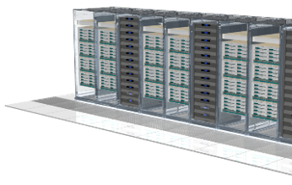
Policy-driven Infrastructure enables Private Cloud
Business Requirements
Application
Operating System
# Users
SLA (Gold, Silver, Bronze)
Etc…
IT Requirements
# VMs
Disk Capacity (MB)
Synchronous Replication
Fault Tolerant
Security Policy
Etc…
Storage Template
Compute Template
Fabric Template
Application Template
Define
Translate
Map
Deploy
Enables business requirements to translate to IT resources
Business owner inputs application, uptime, number of users, business continuity, backup, and security requirements
Resources are rapidly assigned according to user specification reducing time to application availability
Enable choice and flexibility, retain control

Slide 38
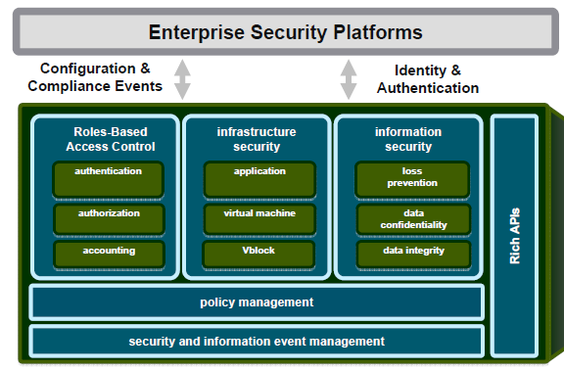
Security Architecture for the Cloud

Slide 39
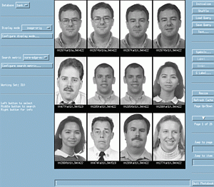
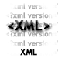
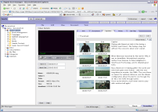
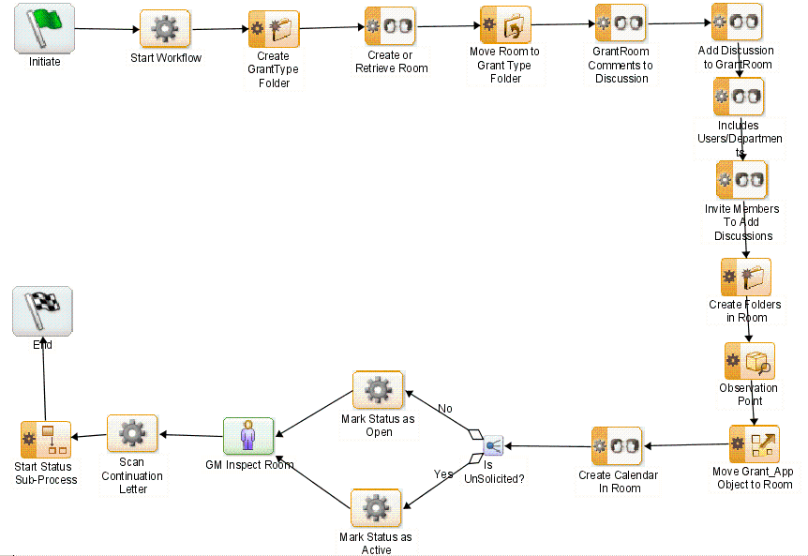








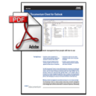


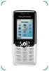
Multi-INT Fusion in an Agile Operation Center Scenario Overview
Single-INT Application
Media WorkSpace
TaskSpace
Case
Management
Collaboration
Content
Security
Media Delivery Services
FTP
Business Process Management
SOAP
MPP Data Warehouse Queries (Big Data)
Populate Virtual Case File with supporting content
Transform
Images
Extract
Metadata
Assemble
Content
.KML
Private
Cloud
Media Transformation Services
Content Store
Integration Services

Slide 40

Journey to the Cloud
85%
95%
Broad adoption of service model
50%
Virtualized, proven solutions
30%
Cloud operating system and model
15%
Virtual data center-centric systems management
Private cloud-enabled infrastructure

Slide 41
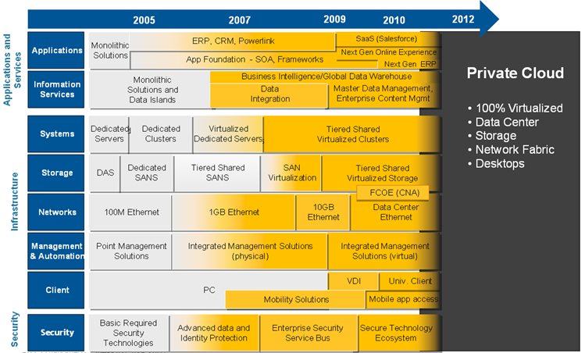
Architect for the Future

Slide 42
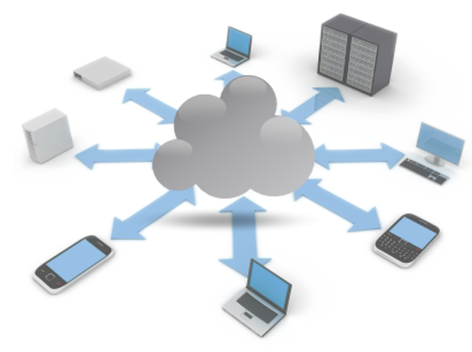
Conclusion
1
Cloud evolution has launched
Adoption will accelerate and last 24-36 months
Converged infrastructure is the foundation
Innovation will be led by market leaders
Cost matters but the need is speed
2
3
4
5

Slide 43

Security challenges in today’s virtualized and cloud environments

Slide 44
The Challenge
Cyber security is major national and economic security issue
Protecting assets and managing access to IT resources has never been more important
Cloud computing is expanding the attack surface and breaking traditional network boundaries.
Do our current security architectures meet the threats?

Slide 45
Security: A Core Component of the Cloud
Trusted
Control
Reliable
Secure
Flexible
Dynamic
On-demand
Efficient
Private Cloud
Federation
Virtualization
Virtualized Data Center
Information
Cloud Computing
Security
Internal cloud
External cloud
45

Slide 46



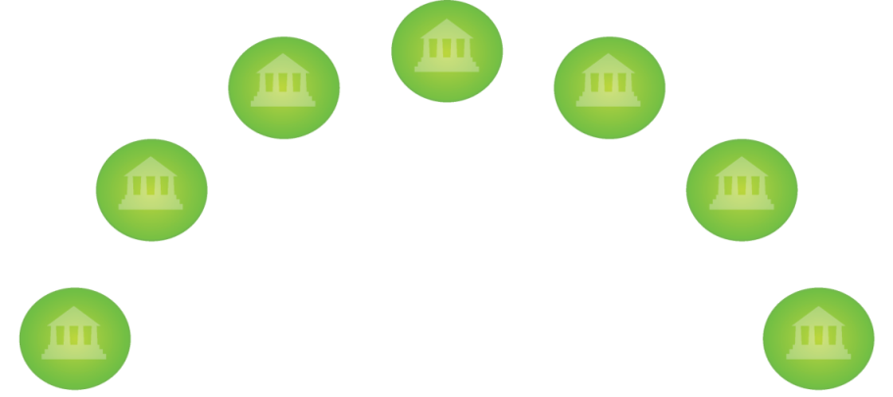

Provide Cybercrime Intelligence Based on Feeds from the Dark Cloud
Dark Cloud
Dark Cloud
Malware
Infection Point
Botnet
Herders
Trojan
Mothership
eFraudNetwork
Hacker Forum
Discussion
USER 3
USER 4
Corp 5
Stolen
Credentials
Database
USER 2
Corp 6
Stolen
Files
Repository
USER 1
Corp 7
GSA
First level of defense: Cybercrime intelligence
Second level of defense: Strong authentication
Third level of defense: Information rights management

Slide 47


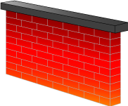
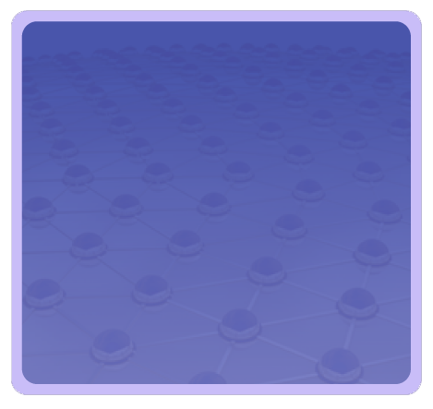
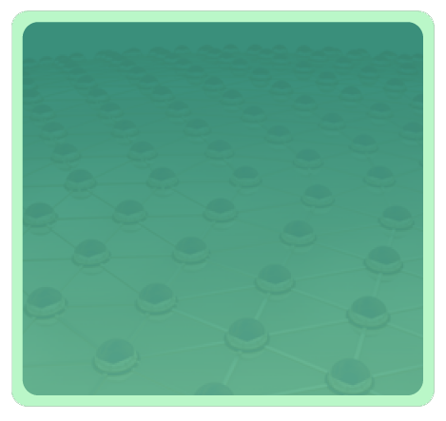










Traditional Computing: The Network Security Perimeter is Aligned with Policy Boundaries
Attackers
APP
APP
APP
APP
APP
APP
APP
APP
OS
OS
OS
OS
OS
OS
OS
OS
Identity
Infor- mation
Infor- mation
Identity
Physical Infrastructure
Physical Infrastructure
Enterprise #1
Enterprise #2

Slide 48






















Adoption of Cloud Computing is Expanding the Enterprise Attack Surface
Remote Employees
Partners
Customers
Channels
Channels
Channels
Partner Entry Points
Partner Entry Points
VPN
IP Sent to
non trusted user
Stolen IP
App, DB or Encryption Key Hack
Fraud
Stolen Credentials
Endpoint
Network
Apps/DB
FS/CMS
Storage
Contractors
Privileged Users
Privileged Users
Privileged Users
Privileged Users
Endpoint theft/loss
Network Leak
Email-IM-HTTP-FTP-etc.
Privileged
User Breach
Inappropriate
Access
Tapes lost or stolen
Public Infrastructure Access Hack
File Server
Backup
Tape
Internal Employees
Enterprise
Applications
Production
Database
Discarded disk exploited
Data Leak
Via USB/Print
(Semi) Trusted User Misuse
Unintentional
Distribution
SharePoint
eRoom, etc.
Business
Analytics
Disk
Arrays
Backup
Disk
Replica

Slide 49



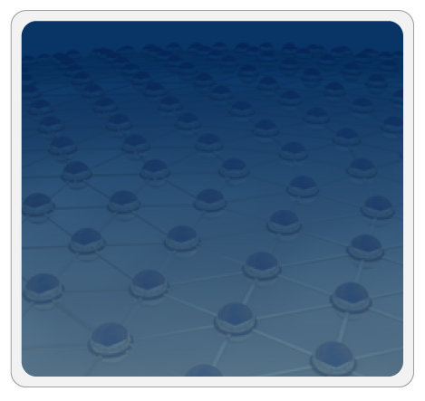


Private Clouds demand a Policy-aware “Trusted Zone” for Data, VMs, and Identities
Attackers
Information
Information
APP
APP
Virtual Infrastructure
APP
APP
APP
APP
Virtual Infrastructure
APP
APP
OS
OS
OS
OS
OS
OS
OS
OS
Identity
Identity
Physical Infrastructure
Physical Infrastructure
Physical Infrastructure
Tenant #1
Cloud Provider
Tenant #2

Slide 50


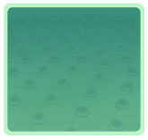


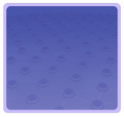



Trusted Zones Key Capabilities
Isolate infrastructure from Malware, Trojans and cybercriminals
Anti-malware
Federate identities with public clouds
Cybercrime intelligence
Identity federation
APP
APP
Tenant #2
OS
OS
Strong authentication
Virtual Infrastructure
Virtual network security
Control and isolate VM in the virtual infrastructure
Isolate information among tenants
APP
APP
Tenant #1
Data loss prevention
OS
OS
Virtual Infrastructure
Segregate and control user access
Isolate information from cloud providers’ employees
Access Mgmt
Encryption & key mgmt
Cloud Provider
Tokenization
Physical Infrastructure
Physical Infrastructure
Security Info. & Event Mgmt
Enable end to end view of security events and compliance across infrastructures
GRC

Slide 51

Virtualization Enables More Effective Security by Pushing Enforcement Down the Stack
vApp and VM layer
APP
APP
APP
APP
Today most security is enforced by the OS and application stack making it ineffective, inconsistent and complex
OS
OS
OS
OS
Pushing information security enforcement in the virtualization and cloud infrastructure ensures consistency, simplifies security management and enables customers to surpass the levels of security possible in today’s physical infrastructures
Virtual and cloud infrastructure
Physical infrastructure

Slide 52
Monitoring and Managing Corporate Policy Compliance
Across virtual, physical, internal and
external infrastructures
Virtual infrastructure management
APP
APP
Tenant #2
OS
OS
Virtual Infrastructure
GRC
APP
APP
Tenant #1
Compliance Dashboard: End-to-end compliance reporting
End-to-end security event management
OS
OS
Virtual Infrastructure
Security configuration and vulnerability management for physical and virtual infrastructures
Cloud Provider
Physical Infrastructure

Slide 53

Securing the Cloud
Securing the virtual datacenter
Federation between internal and external clouds
Security-aware cloud infrastructures
Securing the private cloud
Strong authentication
Access management
Identity protection
Cybercrime monitoring
Securing the public cloud
Delivering products as cloud services
Adaptive Authentication, FraudNetwork
Delivered by MSSP or other cloud providers

Slide 54
Thank you!

Slide 55
Thank you!

